Slide 1
Word Embeddings
John Zhang
(credits: Lecture 2: Word Vector Representations: word2vec by Richard Socher,
CIS 521: Module 14: Natural Language Processing by Chris Callison-Burch,
Speech and Language Processing by Dan Jurafsky)
Notes:
Thursday (open notebook, link to magnitude paper: https://aclanthology.org/D18-2021.pdf)
Ok so hey guys, today I’ll be going a bit more into word embeddings, which are a way to represent words. I believe Phil went into a brief discussion on three dimensional embeddings in lecture last Friday. But today we’ll be going a bit more into maybe the reasoning behind using word embeddings, how word embeddings are actually made, and we’ll be going over a quick application as well.

Slide 2
Discussion Plan
Why we want word vectors (10 mins)
Word2Vec Introduction (10-15 mins)
Library for importing word embeddings called Magnitude, and usage in a simple Named Entity Recognition (NER) model (25-30 min)
Notes:
Teeny bit on word meaning
Then, I’ll introduce this model of learning word vectors called Word2Vec, and this was a model that was introduced by Thomas Mikolov and colleagues at Google in 2013. This strategy for creating word vectors describes the gist of how most simple and powerful word embeddings are created. For example, the Tensorflow embedding layer that Phil showed in lecture last Friday uses a similar strategy.
Then …, (swipe left) … and the reason why libraries like these are created is training these word embeddings takes a long time, so you don’t actually want to retrain them. And then, we’ll be showing how we can …, which is a model that can predict whether a noun is like a person, place, organization, etc., and I’ll be going over these examples in Colab.

Slide 3
Deﬁnition: Meaning (Webster dictionary)
the idea that is represented by a word, phrase, etc.
the idea that a person wants to express by using words, signs, etc.
the idea that is expressed in a work of writing, art, etc.
Notes:
Ok, so that’s the plan. And now we’ll go into discussing word meaning. So we kinda sorta want to have word vectors represent meaning in some way. That’s a pretty controversial idea actually, and I kinda just want to give a few words of context before we dive into that. Okay so if you look up meaning in a dictionary Webster’s says …..
And this is close to the linguistic definition of meaning as well.
But sadly this hasn’t proven to be a notion of meaning that’s very easy for people to make use of in computational systems for dealing with language. For example, if we could have computers understand word meanings like this, they’d be pretty close to having human intelligence right.

Slide 4
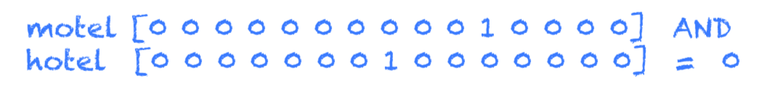
Treating Words as Categorical Variables
With “one-hot” representations, we have the problem:
- Dimensionality: 20K (speech)
You can do slightly better with a frequency rank:
Poll: Penguins Best Bird might have representation:
[708, 1567, 89, 632]
Adélie - 7000
Notes:
But when we create neural networks based off of words, we want them to have some understanding of meaning, right, so they can make good predictions. And that kind of gets into the issue of using standard categorization procedures to encode words for training.
…
… Adelie

Slide 5
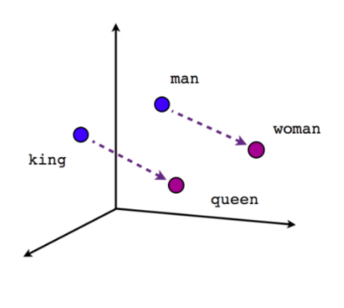
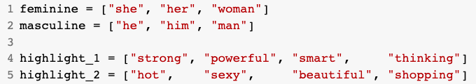
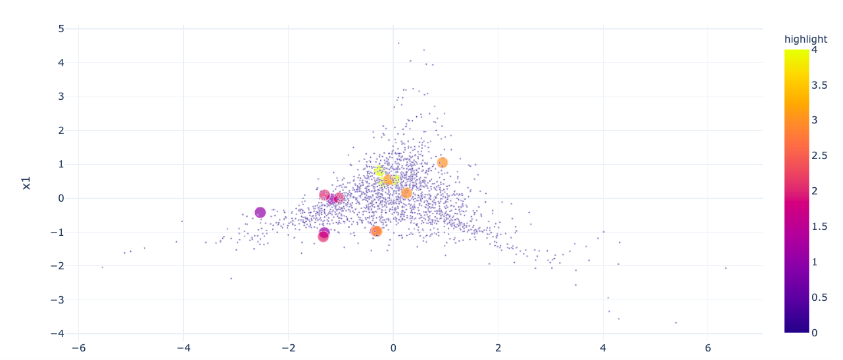
Idea of word embeddings
Notes:
Ok so that gets into the idea of why categorical representations are bad, and why we may want some other way to represent words. And one idea that was introduced in lecture is this concept of word embedding. So it would be great if we could map words to vectors right, and if the directions that these vectors point to, and also like the direction between vectors, had some sort of meaning.
…….
(saw in lec. 3 dimensions could capture some of this, although it was a bit biased).

Slide 6
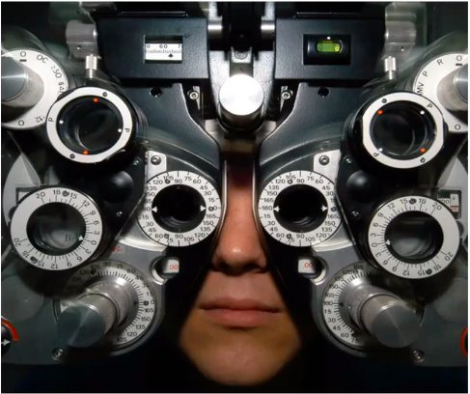
Capturing meaning: Distributional Hypothesis
If we consider optometrist and eye-doctor we find that, as our corpus of utterances grows, these two occur in almost the same environments. In contrast, there are many sentence environments in which optometrist occurs but lawyer does not…
It is a question of the relative frequency of such environments, and of what we will obtain if we ask an informant to substitute any word he wishes for optometrist (not asking what words have the same meaning).
These and similar tests all measure the probability of particular environments occurring with particular elements... If A and B have almost identical environments we say that they are synonyms.
–Zellig Harris (1954)
Notes:
Ok so that gives us an idea of some of the power of word embeddings, but how do we actually create them. And one hypothesis that can be used by computers to capture meaning is this thing called the distributional hypothesis. And this hypothesis was created a long time ago by a professor of linguistics, Zellig Harris, and in his paper, he says …
And this is the hypothesis from linguistics that we’re going to leverage as we build our vector space representation of words.

Slide 7
Intuition of distributional word similarity
Nida (1975) example:
A bottle of tesgüino is on the table
Everybody likes tesgüino
Tesgüino makes you drunk
We make tesgüino out of corn.
From context words humans can guess tesgüino means an alcoholic beverage like beer
Intuition for algorithm:
Two words are similar if they have similar word contexts.
Notes:
And the intuition behind why this matters or why this kind of distributional word similarity is important is that its probably how humans learned words too. So there is this classic example of this word you never heard before tesguino, and if I give you a bunch of sentences containing this word you can infer the meaning of it.
A bottle of…
Intuition for the algorithm we will talk about next is two words are similar, for example beer and tseguino, … .

Slide 8
Word2Vec
Train a classifier on a binary prediction task: “Is word w likely to show up near apricot?”
- learned classifier weights as the word embeddings
In more mathematical terms, assume we’re using a window of ±2 context words:
Want to predict
P(+|tablespoon, apricot)
Notes:
And the algorithm that uses this hypothesis is Word2Vec, the algorithm we will describe that generates word vectors. So what Word2Vec does is it uses running text, so basically just plain old text, …
And the important thing is, we don’t actually care about how well we do on this prediction class; instead we’ll take … . So somehow, these weights themselves are trained to have meaning, and will be used as our word vectors.
…
Our classifier … , where the + represents a positive co-occurrence.

Slide 9
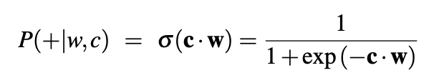

Word2Vec
From linear algebra - two vectors are similar if they have a high dot product.
Word2Vec bases P(+|w, c) on embedding similarity: a word is likely to occur near the target if its embedding vector c is similar to the target embedding w.
Notes:
…
Intuition behind Word2Vec is it bases this probability that we saw before, so the probability of a word given its context, …
But as the dot product is not a probability, we use something like the sigmoid function to convert it to one. So we use this formula for the probability.
And then for the negative probability, or the probability that word c is not a real context word for w, we just take one minus the positive probability.

Slide 10
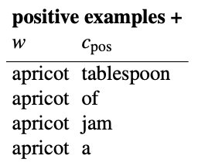
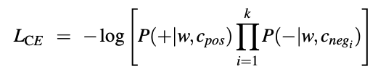
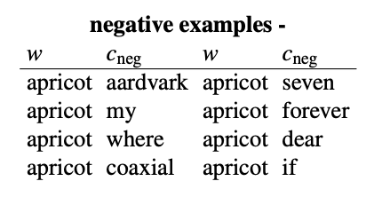
Word2Vec
Notes:
So how do these probabilities come into play when training Word2Vec. So let’s consider the example that we saw before … (improvise)
So given these sets of positive and negative training instances, and an initial set of embeddings, which can be set randomly, the goal of word2vec is to adjust these embeddings so that we maximize the similarity of these word pairs (circle), so the target word to positive examples. And simultaneously minimize the similarity between these word pairs.
And how we would do that is actually really easy, we just want to minimize the loss where parts of the loss have this form. So here, we just fix choosing k negative terms for each positive term, and we also implicitly assume independence between the context words. And minimizing this loss does exactly what we want.
And before we move on, I want to note that from what we’ve seen so far, there seems to be two kinds of embeddings, one for the target embedding w, and those for the context embeddings c, and this is exactly true.

Slide 11
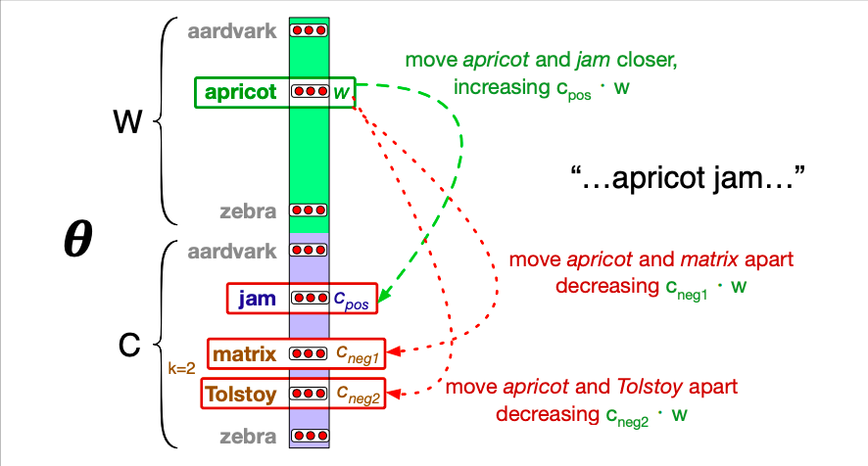
Word2Vec
Notes:
So word2Vec trains two separate sets of embeddings as we can see here, the target embeddings W, and the context embeddings C, so each word will have two embeddings.
So this is a diagram just describing what happens when we minimize the loss, for example using SGD. So for our apricot jam example, one iteration of SGD will …
And this will happen for all of the contexts in our data, so we’ll be moving all of these vectors at once. And we’ll keep on shifting and shifting the embeddings for these words until we stabilize. And then we’ll have our word vectors. So you can imagine for example that for two words like orange and clementine, if they appear in a lot of the same contexts, this training will at least make their (circle) target embeddings very similar.
So yeah, this is a description of how to generate Word2Vec vectors. I believe for Word2Vec for each word you actually concatenate the final target and context embedding. So yeah, I know that was maybe a lot to take in on vector generation, so does anyone have any questions about that?
_________
Ok cool, so now we can move on to an example of how these vectors are used in practice.

